Slide 1
ESE 461 FINAL PROJECT
Amelia Ma, Daniel Skelton, Daniel Sullivan

Slide 2
Design Principles & Strategies
Principles:
Aim for low power, small area with acceptable performance
Strategies:
Keep the size of RAMs small and load them repeatedly
Reuse Units that are idle most of the time
Pipeline the first and second layer of the design

Slide 3
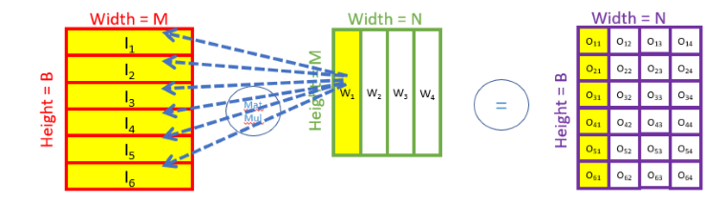


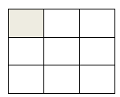
Design Choice: Data Reuse (Layer 1)
784
200
200
Single round (784 multiplications & accumulations)
784
10
10
Input
Weight[1]
Temporary Layer
readmem
Single clock cycle (load 10 inputs and 1 weight[1])
Use the one with the least area among the data reuse strategies
Use readmem to read external memory (Input and Weight[1])

Slide 4

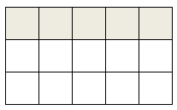
Design Choice: Data Reuse (Layer 2)
200
10
readmem
10
10
200
10
Temporary Layer
Weight[2]
GSRAM(partial sum)
Data reuse in Layer 2: fill the GSRAM with partial sums
Use readmem to read in Weight[2] one row at a time

Slide 5
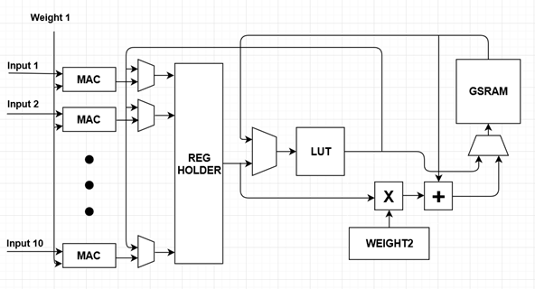
Datapath
LAYER 1
LAYER 2

Slide 6
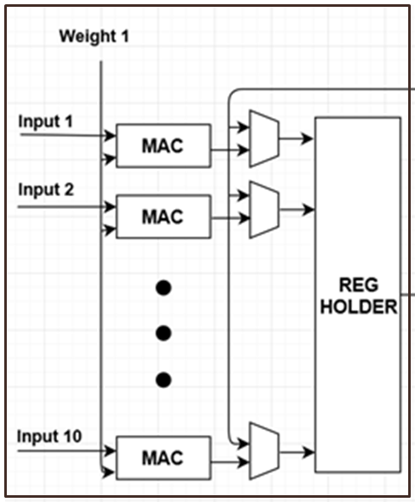
Datapath Layer 1
MAC: Combinational, 1 multiplication / cycle
- Can make it sequential and save area
Reg Holder: 10*16-bit Register file, holds the sum of each round (784 accumulations)

Slide 7
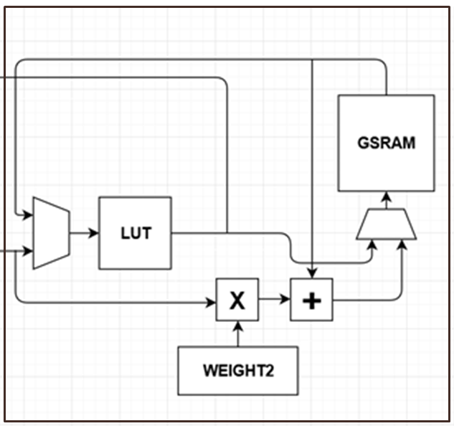
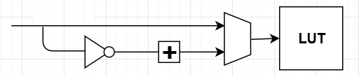
DataPath Layer 2:
LUT: Hard-coded Sigmoid function used for both Layer 1 and 2
- Only stores half of the values and flips the first bit to get the other half
GSRAM: 10*16-bit Register file, output SRAM, also holds the partial sum

Slide 8
Pipelining: Layer 1 & 2
Layer 1:
784 (accumulations)
Layer 2:
10*2 (REG+LUT) +
10*10*2 (GSRAM)
Hidden cost
Total time (in clock cycles) ~= 784 * 200
784 * 200 + 200(last GSRAM) + 100(final activation)

Slide 9
Controller
in
mux
addr_row
addr_col
mux
addr
loadNextRow
in
addr
reset
mux

Slide 10
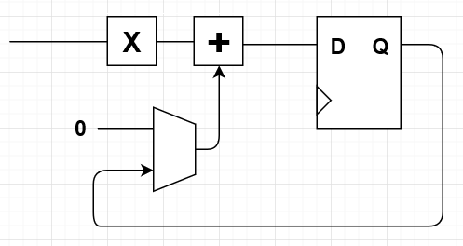
Controller: MAC_reset
MAC_reset controls the data put into the adder (HIGH: 0, LOW: data from the register that stores the partial sum)
Eliminates one clock cycle delay

Slide 11
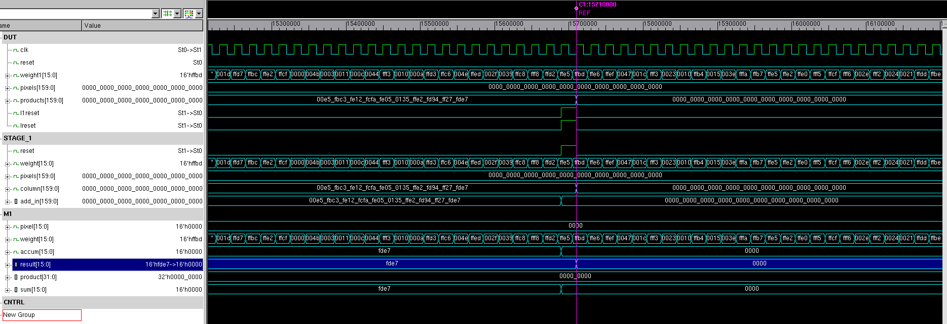
Layer 1 Simulation

Slide 12
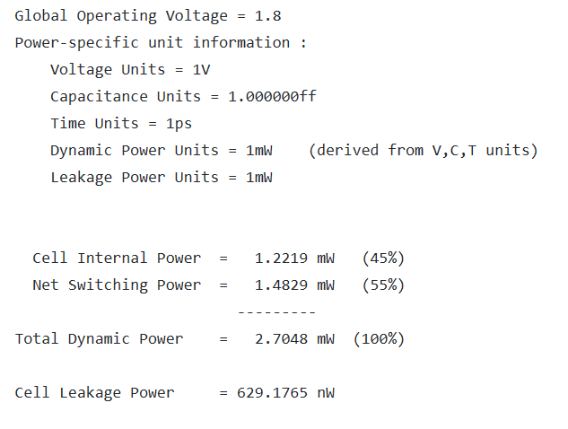
Layer 1 Power Report

Slide 13
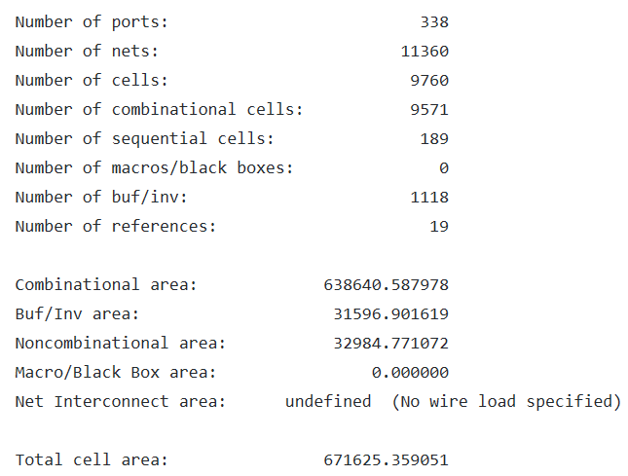
Layer 1 Area report

Slide 14
Future Plans
Finish up: Top level Synthesis and design compiler
Optimization:
- Clock gating
- Reduce large fan-ins and fan-outs
- Find and reduce critical path
- Fix SRAM optimization

